Slide 1
Management Information System (MIS Software)
nhp.mowr.gov.in
NATIONAL HYDROLOGY PROJECT
GOVERNMENT OF INDIA, MINISTRY OF JAL SHAKTI
DEPARTMENT OF WATER RESOURCES, RD & GR

Slide 2
PROJECT OBJECTIVE
Strengthening of national and sub-national water information centres through standardization of databases and strengthening of national and sub-national water information centres WRIS’s.
Building capacity for knowledge-based water resources management. It will support establishment of:
Water resources knowledge centres
Professional development
Project management
Operational support.
02
04
01
03
Establishment/modernization of new and existing hydromet monitoring systems and construction of hydro-informatics centres that capture both water resources and uses.
Development of analytical tools and decision-support platform (river basin modelling, stream flow forecasting and reservoir operation systems, and irrigation design and operations).

Slide 3
TODAY’S SESSION
Procurement Management Process
Expenditure Management
Document Management
Tender Management
Reports
Live Demonstration
Q&A Session
AWP Creation & Modification
AWP provision for ongoing activities
New Package Creation
Package Cancellation and Re-biding
Updating Milestones
Tracking Procurement Progress
Syncing of MIS & STEP
Expenditure Management
Procurement Document Review process
KEY FOCUS ON

Slide 4
MIS FEATURES
Project Dashboard
Finance Management
Procurement Management
Hydrological Information System Management
Document Management
Purpose Driven Study (PDS)
Tender Management
Training & workshop Management
Audit
Event Management
Reports
Help/ Manuals e-Bulletins

Slide 5
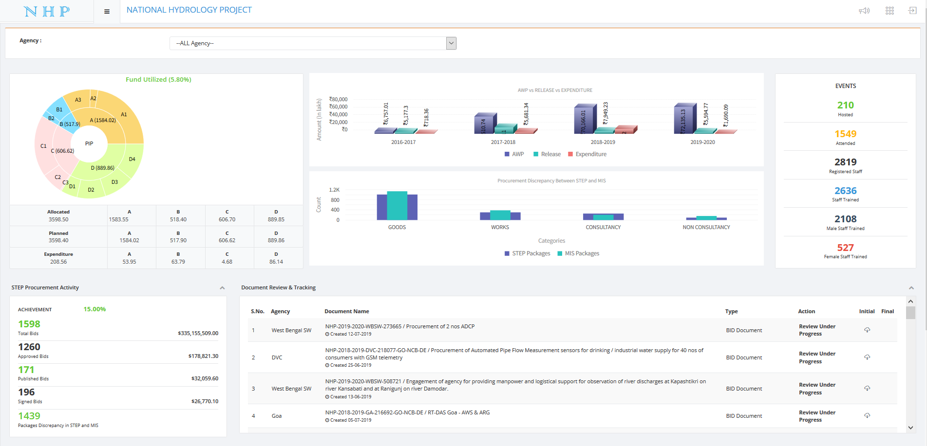
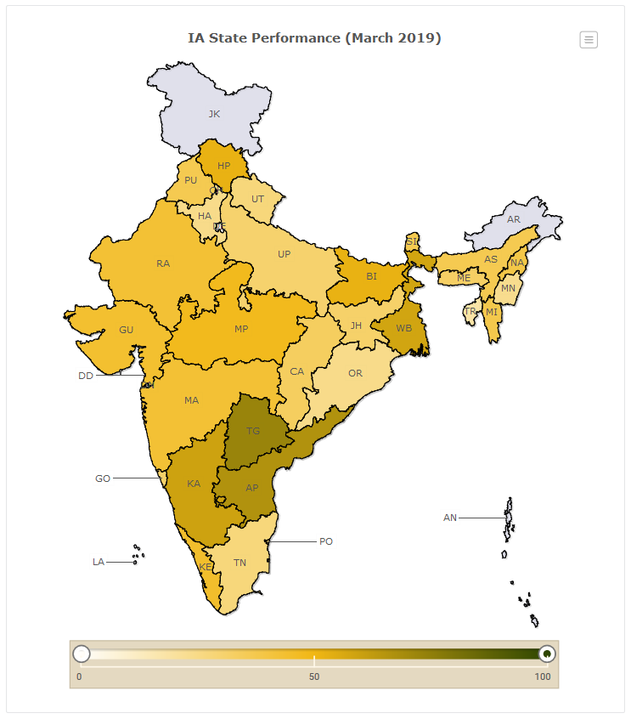
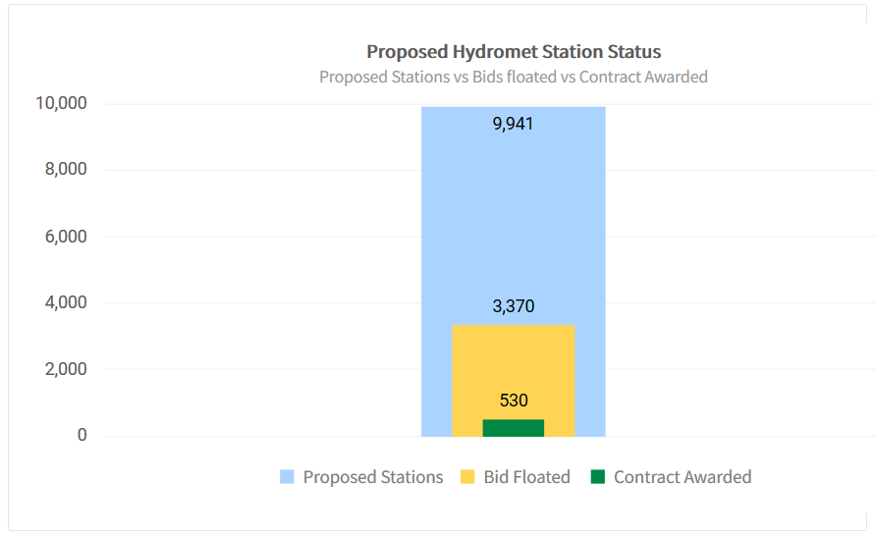
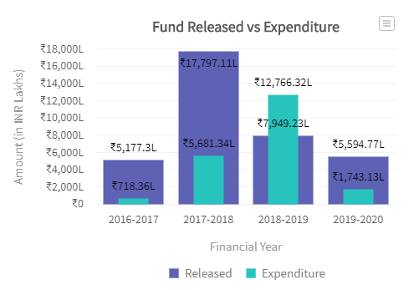
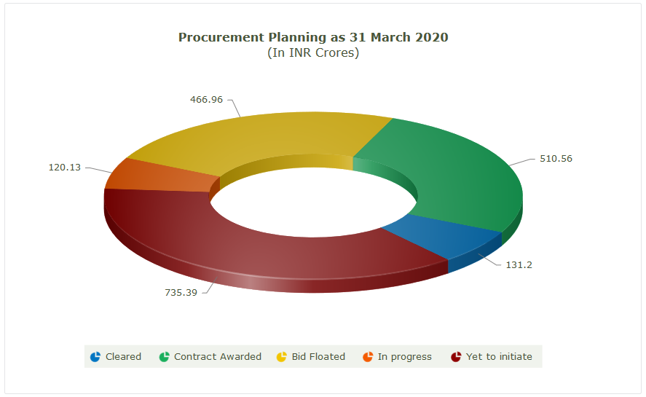
PROJECT DASHBOARD

Slide 6
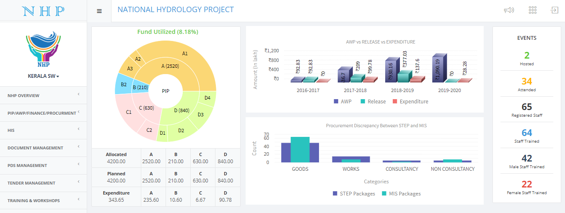
AGENCY DASHBOARD

Slide 7
FINANCE
Project Implementation Planning (PIP) Management
Budget Allocation & Monitoring Management
Annual Work Plan (AWP) Management
Expenditure Management
Utilization of Fund & Certificate Management
Audit Monitoring & Management

Slide 8
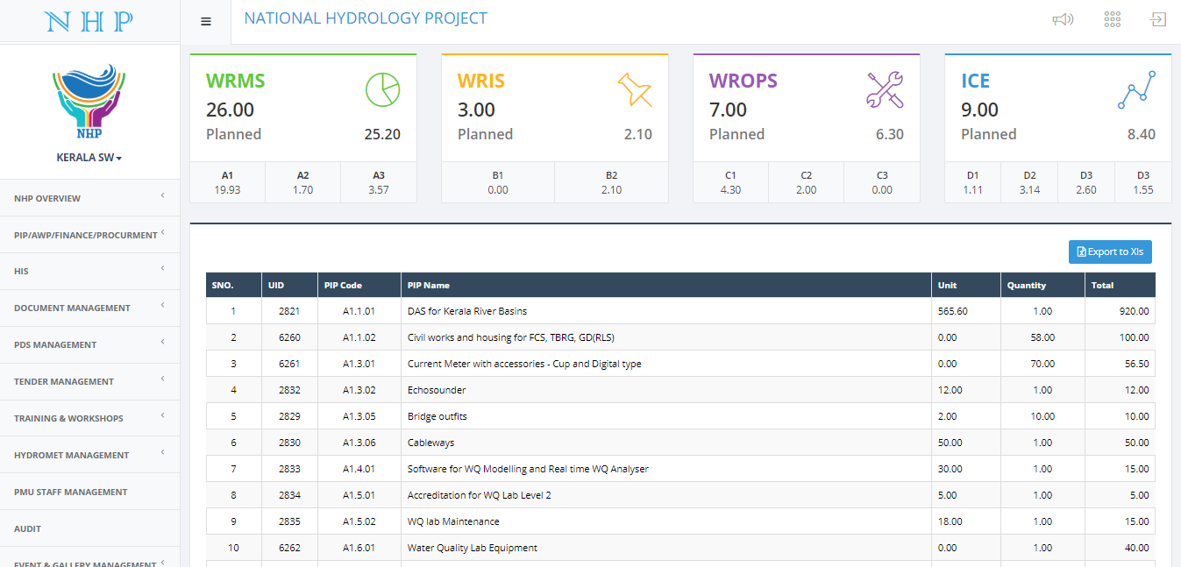
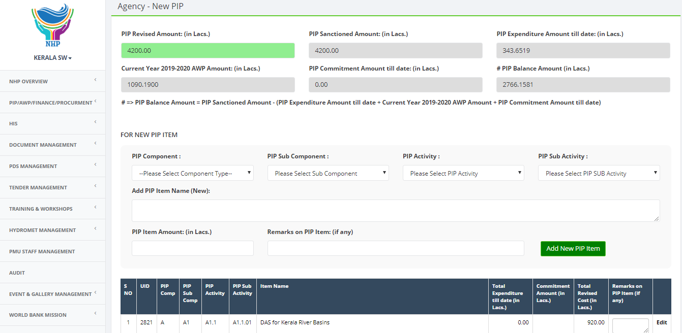
FINANCE – PIP & REVISED PIP
Project Implementation Planning (PIP)
Interface for Project Implementation Planning (PIP) revision

Slide 9
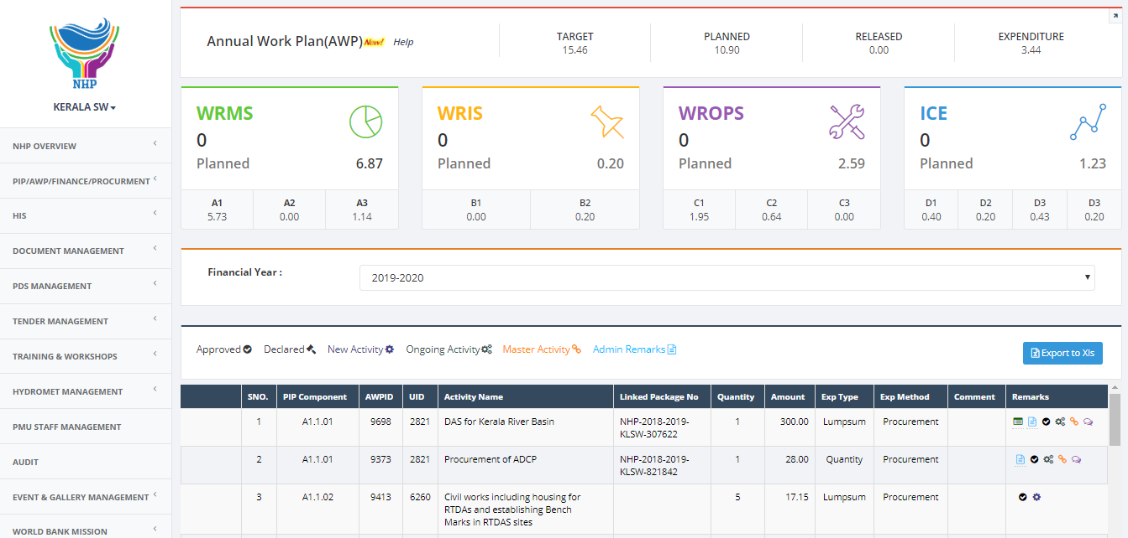
FINANCE – ANNUAL WORK PLAN

Slide 10
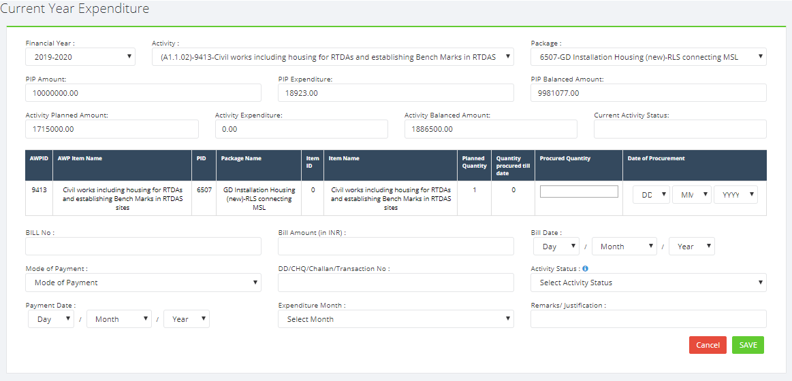
FINANCE – EXPENDITURE BOOKING
Current year expenditure booking
Previous year expenditure booked in current FY

Slide 11
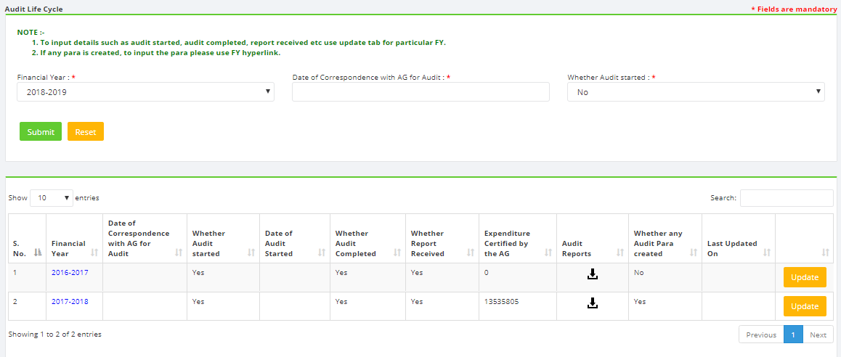
FINANCE – UTILIZATION CERTIFICATE & AUDIT
Utilization certificate
Audit

Slide 12
PROCUREMENT
Procurement Planning Management
Re-bid
Cancel Procurement Package
Procurement Milestone
Integration with STEP (World Bank)
Bid Document Management
Tender Management

Slide 13
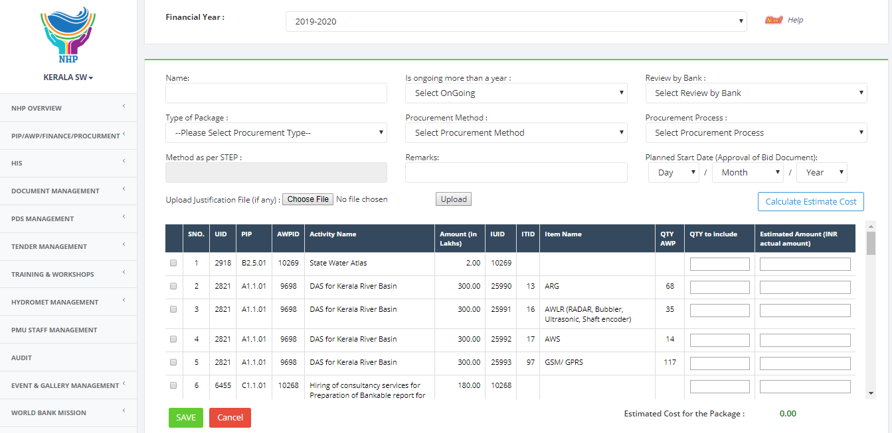
PROCUREMENT – PACKAGE CREATION

Slide 14
PROCUREMENT – CREATING NEW PLAN

Slide 15
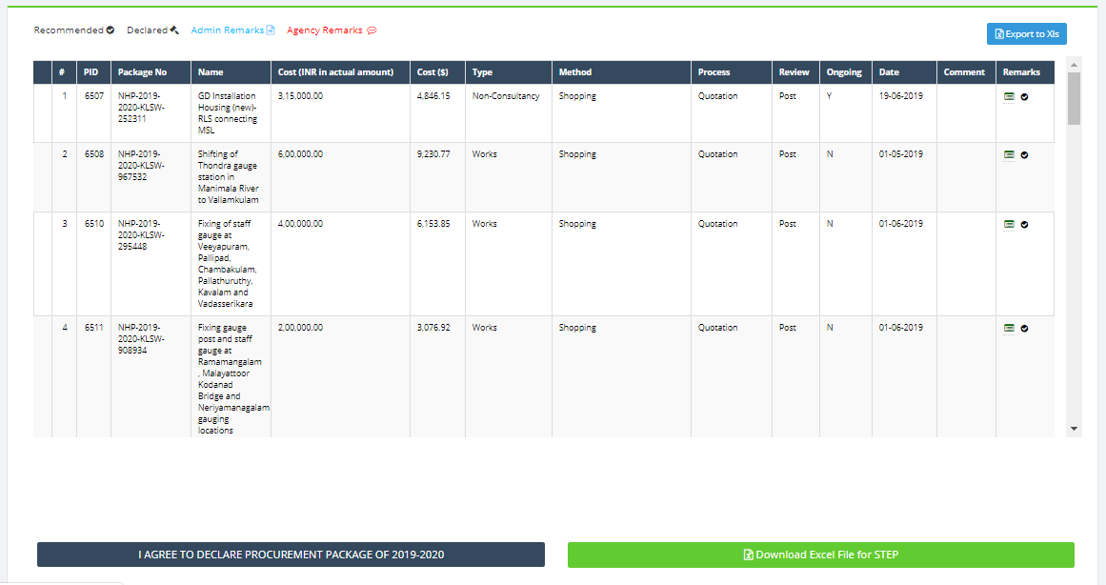
PROCUREMENT - PLAN

Slide 16
PROCUREMENT – RE-BID

Slide 17
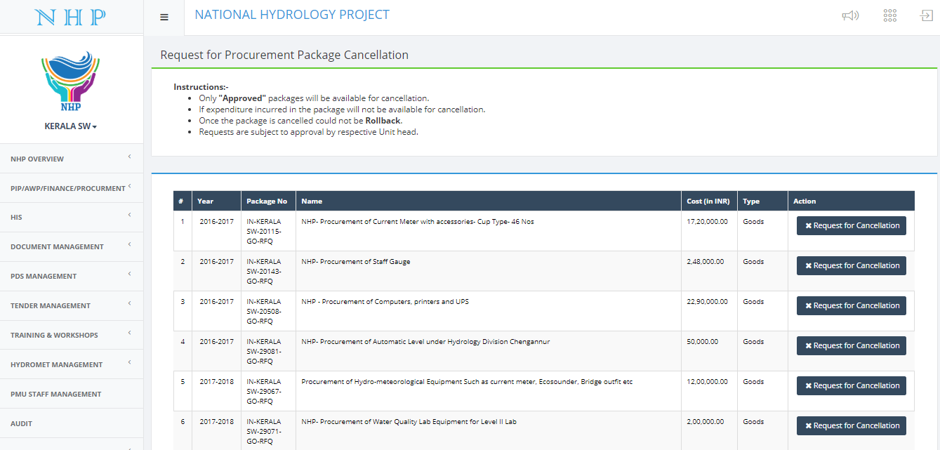
PROCUREMENT – PACKAGE CANCELLATION

Slide 18
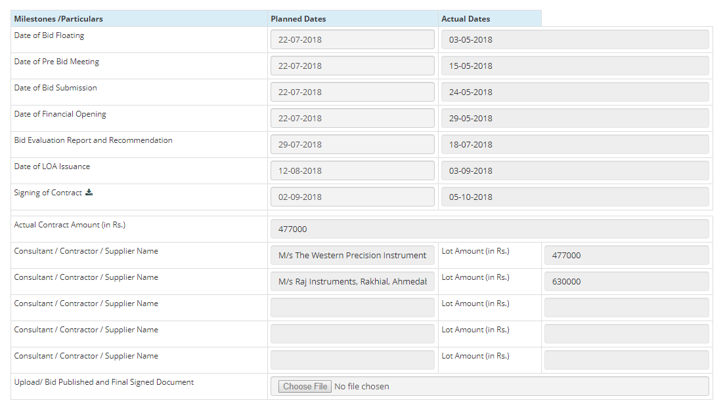
PROCUREMENT – MILESTONE

Slide 19
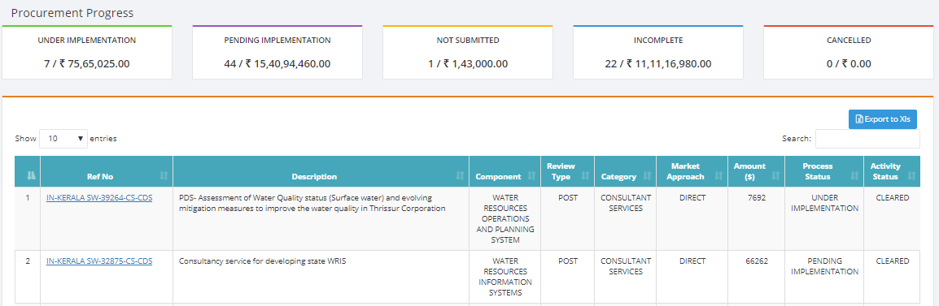
PROCUREMENT – INTEGRATION WITH STEP
Uploading STEP data to MIS
Updated STEP data in MIS from STEP
MIS & STEP data discrepancy

Slide 20
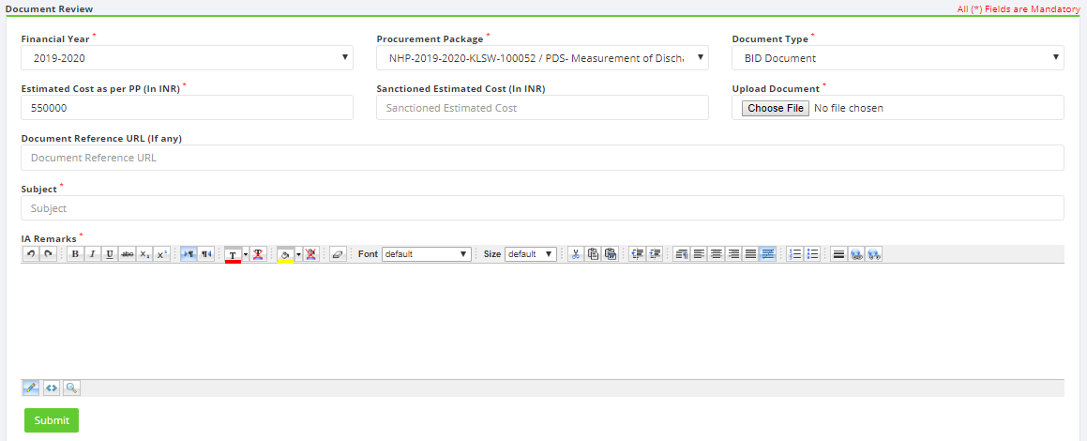
PROCUREMENT – DOCUMENT REVIEW

Slide 21
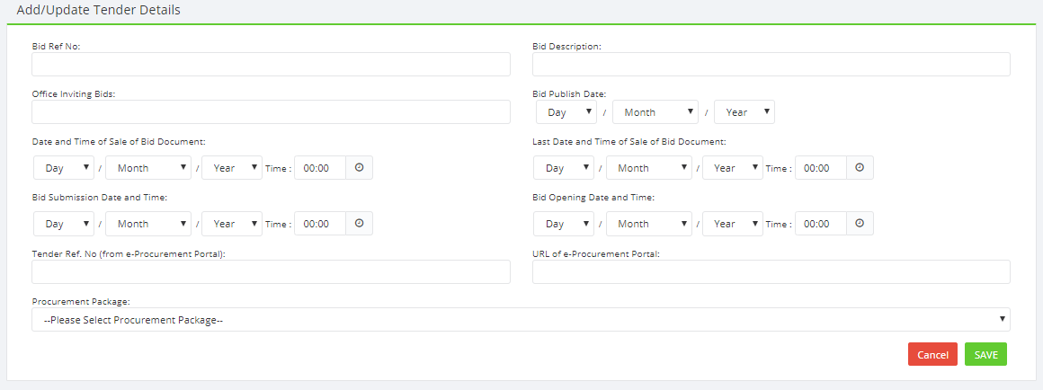
PROCUREMENT – TENDER MANAGEMENT

Slide 22
HYDROLOGICAL INFORMATION SYSTEM (HIS)
Vendor Management
Equipment Management
Hydromet Network Design
Vendor Comparative Statements
Model Management
Modeller Management

Slide 23
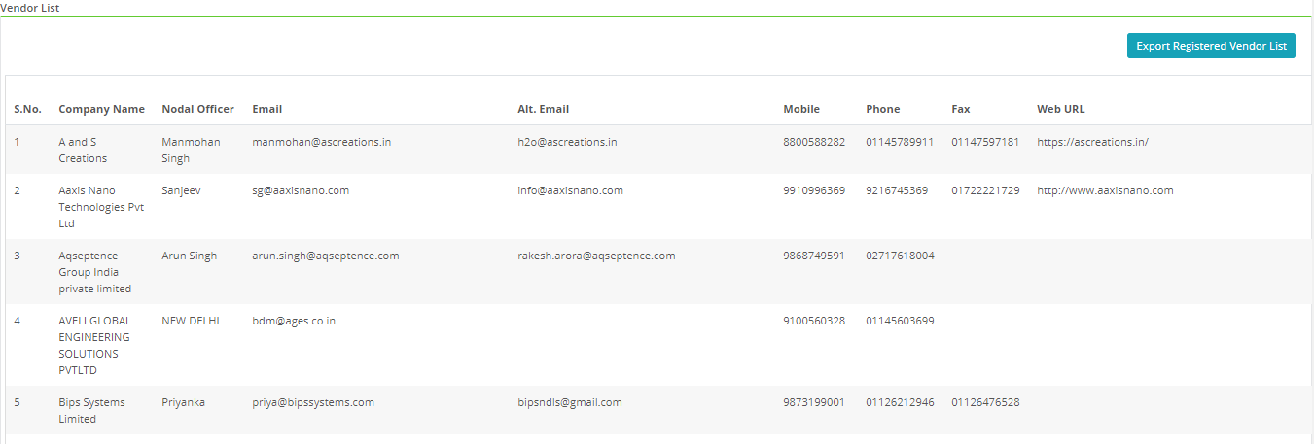
HIS – VENDOR REGISTRATION

Slide 24
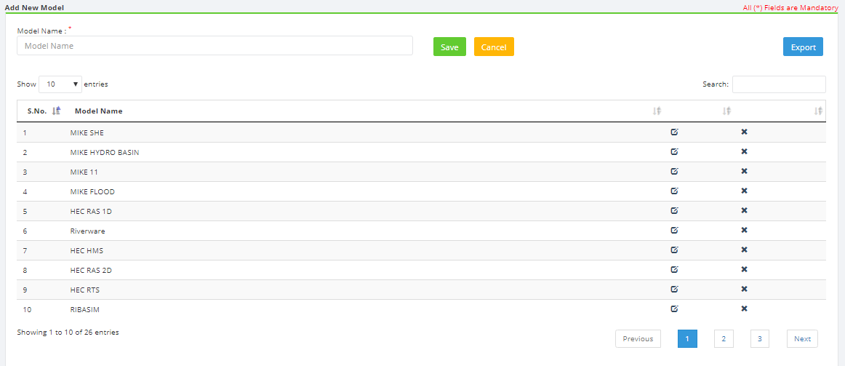
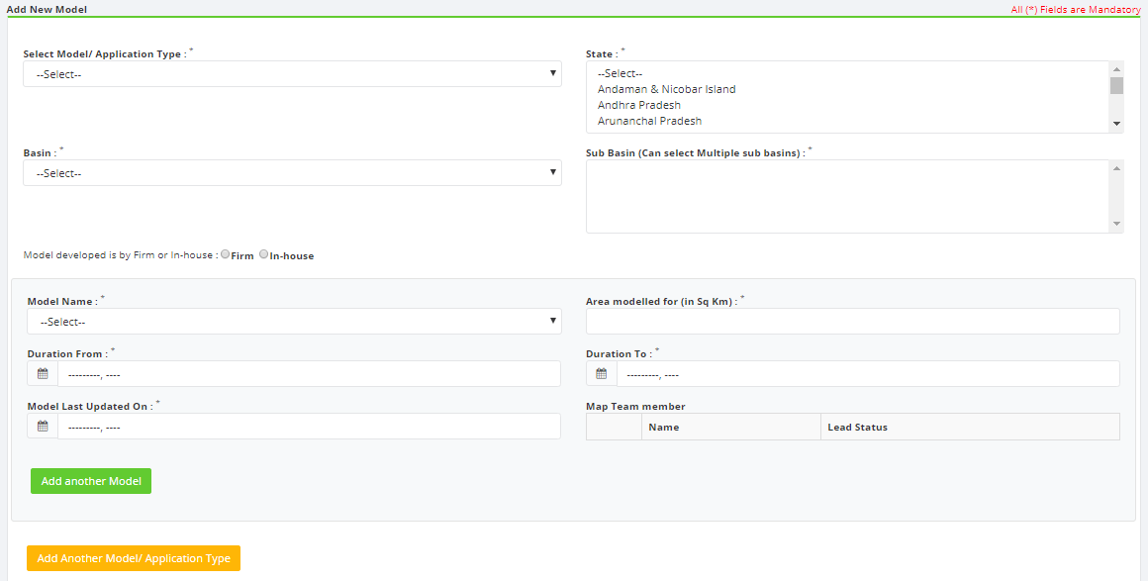
HIS – ADD A MODEL & MAP MODELS

Slide 25
EVENT & GALLERY MANAGEMENT
Events Management
Event Calendar
Participant Registration
Event Material
Event Gallery
International Conference Management

Slide 26
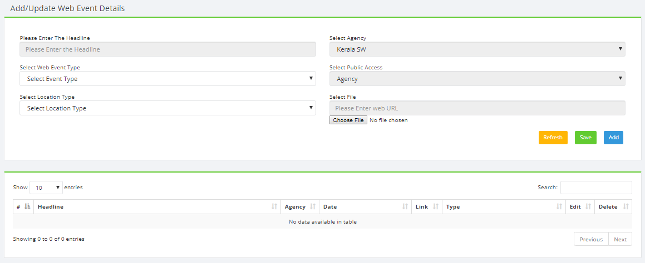
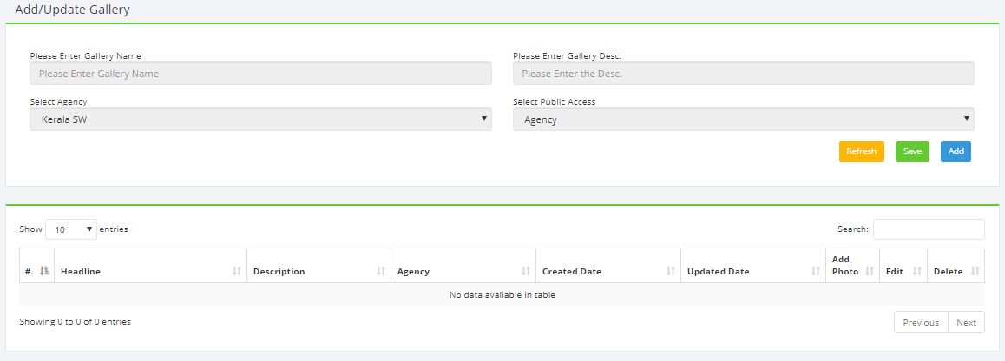
EVENT & GALLERY MANAGEMENT

Slide 27
THANK YOU

